Slide 1
Chapter 5: Making Decisions

Slide 2
Objectives
Plan decision-making logic
Make decisions with the if and if…else statements
Use multiple statements in if and if…else clauses
Nest if and if…else statements
Use AND and OR operators
Java Programming, Eighth Edition

Slide 3
Objectives (cont’d.)
Make accurate and efficient decisions
Use the switch statement
Use the conditional and NOT operators
Assess operator precedence
Add decisions and constructors to instance methods
Java Programming, Eighth Edition

Slide 4
Planning Decision-Making Logic
Pseudocode
  Use paper and a pencil
  Plan a program’s logic by writing plain English statements
  Accomplish important steps in a given task
  Use everyday language
Flowchart
  Steps in diagram form
  A series of shapes connected by arrows
Java Programming, Eighth Edition

Slide 5
Planning Decision-Making Logic (cont’d.)
Flowchart (cont’d.)
  Programmers use a variety of shapes for different tasks
    Rectangle to represent any unconditional step
    Diamond to represent any decision
Sequence structure
  One step follows another unconditionally
  Cannot branch away or skip a step
Java Programming, Eighth Edition

Slide 6
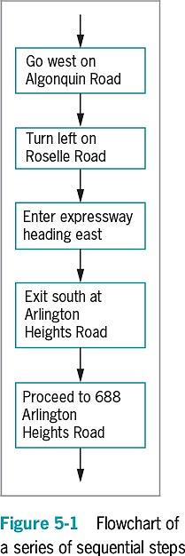
Java Programming, Eighth Edition

Slide 7
Planning Decision-Making Logic (cont’d.)
Decision structure
  Involves choosing among alternative courses of action
  Based on some value within a program
All computer decisions are yes-or-no decisions
Boolean values
  true and false values
  Used in every computer decision
Java Programming, Eighth Edition

Slide 8
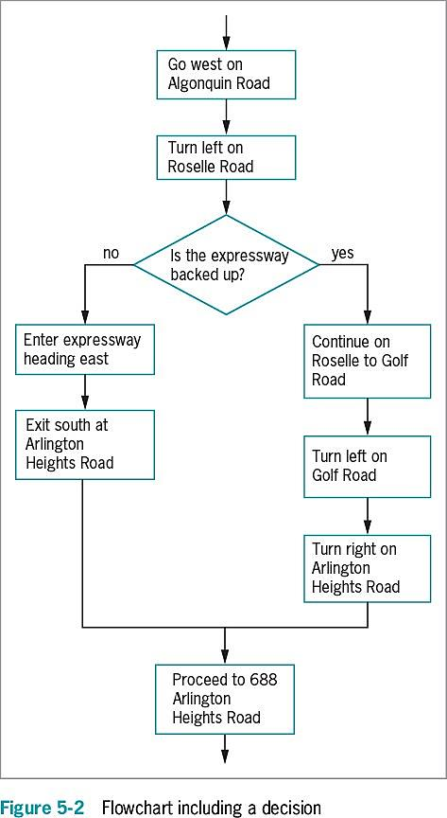
Java Programming, Eighth Edition

Slide 9
The if and if…else Statements
if statement
  The simplest statement to make a decision
  A Boolean expression appears within parentheses
  No space between the keyword if and the opening parenthesis
  Execution always continues to the next independent statement
  Use a double equal sign ( == ) to determine equivalency
Java Programming, Eighth Edition

Slide 10
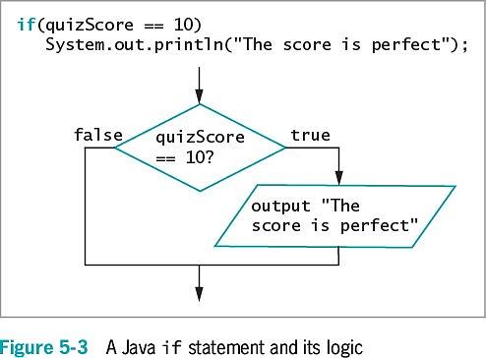
The if and if…else Statements (cont’d.)
Java Programming, Eighth Edition

Slide 11
Pitfall: Misplacing a Semicolon in an if Statement
There should be no semicolon at the end of the first line of the if statement
  if(someVariable == 10)
  The statement does not end there
When a semicolon follows if directly:
  An empty statement contains only a semicolon
  Execution continues with the next independent statement
Java Programming, Eighth Edition

Slide 12
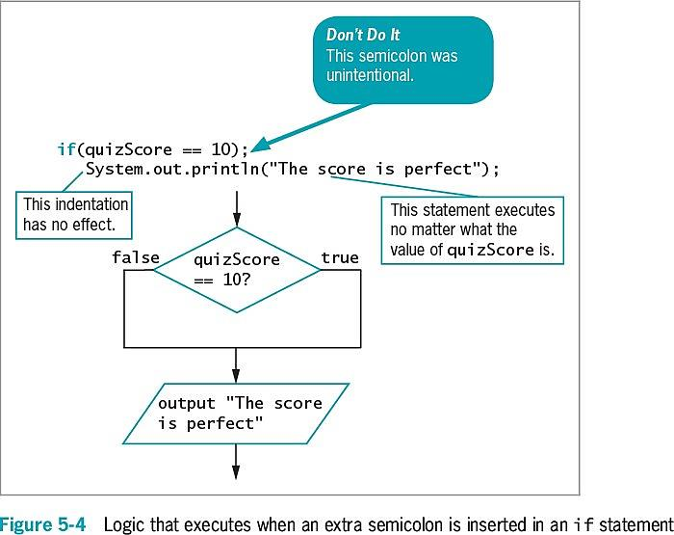
Pitfall: Misplacing a Semicolon in an if Statement (cont’d.)
Java Programming, Eighth Edition

Slide 13
Pitfall: Using the Assignment Operator Instead of the Equivalency Operator
Attempt to determine equivalency
  Using a single equal sign rather than a double equal sign is illegal
You can store a Boolean expression’s value in a Boolean variable before using it in an if statement
Java Programming, Eighth Edition

Slide 14
Pitfall: Attempting to Compare Objects Using the Relational Operators
Use standard relational operators to compare values of primitive data types
  Not objects
You can use the equals and not equals comparisons
( == and != ) with objects
  Compare objects’ memory addresses instead of values
Java Programming, Eighth Edition

Slide 15
The if…else Statement
Single-alternative if
  Perform an action, or not
    Based on one alternative
Dual-alternative if
  Two possible courses of action
if…else statement
  Performs one action when a Boolean expression evaluates as true
  Performs a different action when a Boolean expression evaluates as false
Java Programming, Eighth Edition

Slide 16
The if…else Statement (cont’d.)
if…else statement (cont’d.)
  A statement that executes when if is true or false and ends with a semicolon
  Vertically align the keyword if with the keyword else
  Illegal to code else without if
  Depending on the evaluation of the Boolean expression following if, only one resulting action takes place
Java Programming, Eighth Edition

Slide 17
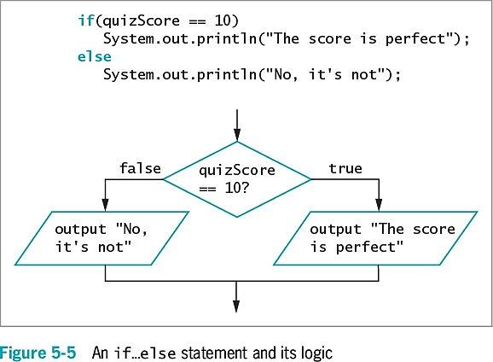
The if…else Statement (cont’d.)
Java Programming, Eighth Edition

Slide 18
Using Multiple Statements in if and if…else Clauses
To execute more than one statement, use a pair of curly braces
  Place dependent statements within a block
  Crucial to place the curly braces correctly
Any variable declared within a block is local to that block
Java Programming, Eighth Edition

Slide 19
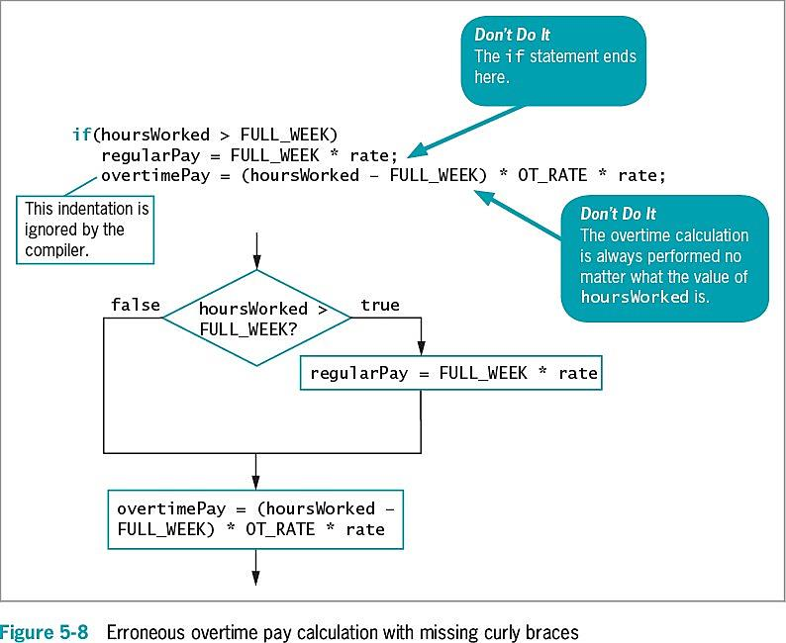
Using Multiple Statements in if and if…else Clauses (cont’d.)
Java Programming, Eighth Edition

Slide 20
Nesting if and if…else Statements
Nested if statements
  Statements in which an if structure is contained inside another if structure
  Two conditions must be met before some action is taken
Pay careful attention to the placement of else clauses
else statements are always associated with if on a “first in-last out” basis
Java Programming, Eighth Edition

Slide 21
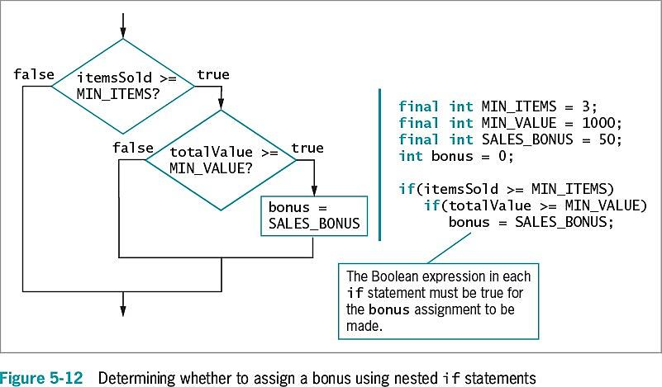
Nesting if and if…else Statements (cont’d.)
Java Programming, Eighth Edition

Slide 22
Using Logical AND and OR Operators
The logical AND operator
  An alternative to some nested if statements
  Used between two Boolean expressions to determine whether both are true
  Written as two ampersands ( && )
    Include a complete Boolean expression on each side
  Both Boolean expressions that surround the operator must be true before the action in the statement can occur
Java Programming, Eighth Edition

Slide 23
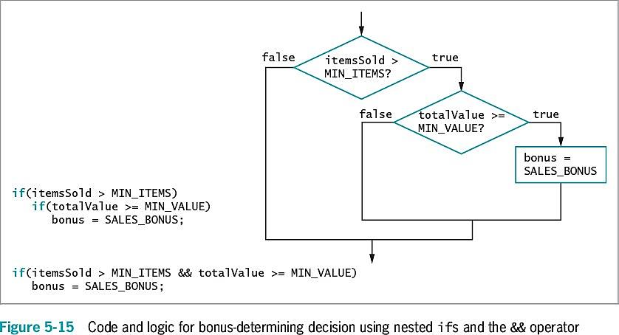
Using Logical AND and OR Operators (cont’d.)
Java Programming, Eighth Edition

Slide 24
Using Logical AND and OR Operators (cont’d.)
The OR operator
  An action to occur when at least one of two conditions is true
  Written as ||
    Sometimes called pipes
Java Programming, Eighth Edition

Slide 25
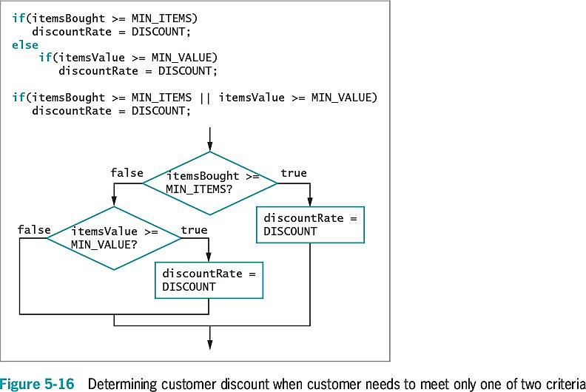
Using Logical AND and OR Operators (cont’d.)
Java Programming, Eighth Edition

Slide 26
Using Logical AND and OR Operators (cont’d.)
Short-circuit evaluation
  Expressions on each side of the logical operator are evaluated only as far as necessary
  Determine whether an expression is true or false
Java Programming, Eighth Edition

Slide 27
Making Accurate and Efficient Decisions
Making accurate range checks
  Range check: a series of if statements that determine whether a value falls within a specified range
  Java programmers commonly place each else of a subsequent if on the same line
  Within a nested if…else statement:
    It is most efficient to ask the most likely question first
    Avoid asking multiple questions
Java Programming, Eighth Edition

Slide 28
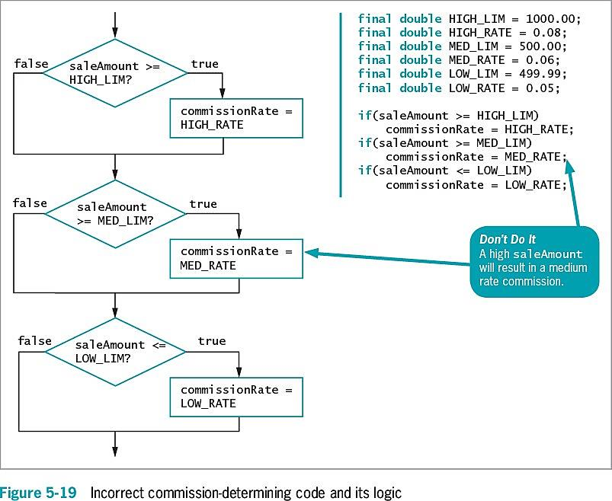
Making Accurate and Efficient Decisions (cont’d.)
Java Programming, Eighth Edition

Slide 29
Making Accurate and Efficient Decisions (cont’d.)
It is most efficient to ask a question most likely to be true first
  Avoids asking multiple questions
  Makes a sequence of decisions more efficient
Java Programming, Eighth Edition

Slide 30
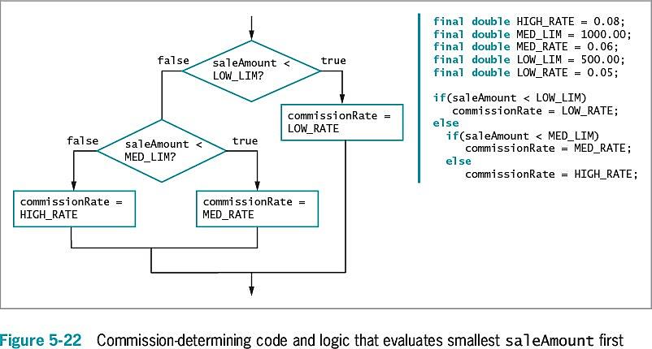
Making Accurate and Efficient Decisions (cont’d.)
Java Programming, Eighth Edition

Slide 31
Using && and || Appropriately
Errors of beginning programmers:
  Using the AND operator when they mean to use OR
    Example: No payRate value can ever be both less than 5.65 and more than 60 at the same time
    if(payRate < LOW && payRate > HIGH)
      System.out.println("Error in pay rate");
    Use pipes “||” operator instead
  Using a single ampersand or pipe to indicate a logical AND or OR
Java Programming, Eighth Edition

Slide 32
Using the switch Statement
switch statement
  An alternative to a series of nested if statements
  Test a single variable against a series of exact integer, character, or string values
Java Programming, Eighth Edition

Slide 33
Using the switch Statement (cont’d.)
Keywords
  switch
    Starts the structure
    Followed by a test expression enclosed in parentheses
  case
    Followed by one of the possible values for the test expression and a colon
Java Programming, Eighth Edition

Slide 34
Using the switch Statement (cont’d.)
Keywords (cont’d.)
  break
    Optionally terminates a switch statement at the end of each case
  default
    Optionally is used prior to any action that should occur if the test variable does not match any case
Java Programming, Eighth Edition

Slide 35
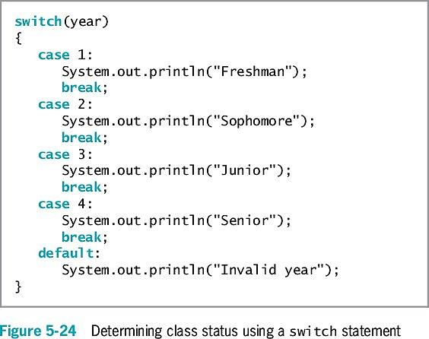
Using the switch Statement (cont’d.)
Java Programming, Eighth Edition

Slide 36
Using the switch Statement (cont’d.)
break statements in the switch structure
  If a break statement is omitted:
    The program finds a match for the test variable
    All statements within the switch statement execute from that point forward
case statement
  No need to write code for each case
  Evaluate char variables
    Ignore whether it is uppercase or lowercase
Java Programming, Eighth Edition

Slide 37
Using the switch Statement (cont’d.)
Why use switch statements?
  They are convenient when several alternative courses of action depend on a single integer, character, or string value
  Use only when there is a reasonable number of specific matching values to be tested
Java Programming, Eighth Edition

Slide 38
Using the Conditional and NOT Operators
Conditional operator
  Requires three expressions separated with a question mark and a colon
  Used as an abbreviated version of the if…else structure
  You are never required to use it
Syntax of a conditional operator:
  testExpression ? trueResult : falseResult;
Java Programming, Eighth Edition

Slide 39
Using the Conditional and NOT Operators (cont’d.)
A Boolean expression is evaluated as true or false
  If the value of testExpression is true:
    The entire conditional expression takes on the value of the expression following the question mark
  If the value is false:
    The entire expression takes on the value of falseResult
An advantage of using the conditional operator is the conciseness of the statement
Java Programming, Eighth Edition

Slide 40
Using the NOT Operator
NOT operator
  Written as an exclamation point ( ! )
  Negates the result of any Boolean expression
  When preceded by the NOT operator, any expression evaluated as:
    true becomes false
    false becomes true
Statements with the NOT operator:
  Are harder to read
  Require a double set of parentheses
Java Programming, Eighth Edition

Slide 41
Understanding Operator Precedence
Combine as many AND or OR operators as needed
An operator’s precedence
  How an expression is evaluated
  The order agrees with common algebraic usage
    Arithmetic is done first
    Assignment is done last
    The AND operator is evaluated before the OR operator
    Statements in parentheses are evaluated first
Java Programming, Eighth Edition

Slide 42
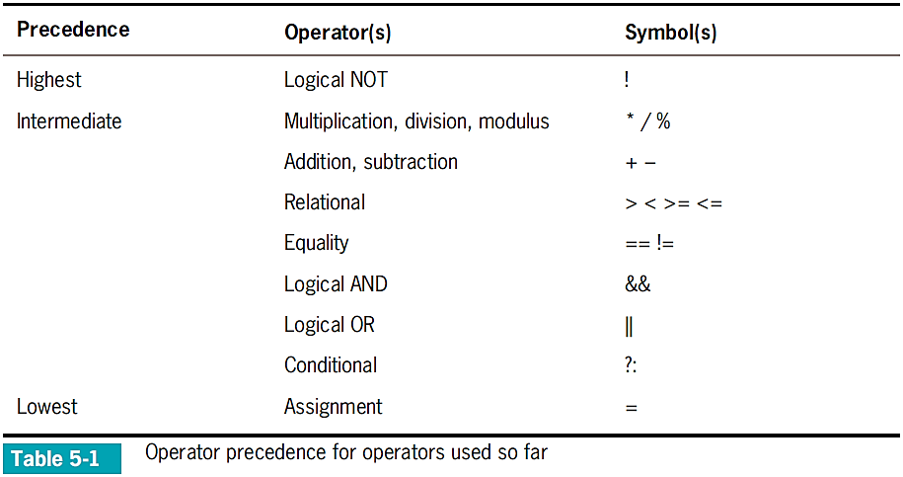
Understanding Operator Precedence (cont’d.)
Java Programming, Eighth Edition

Slide 43
Understanding Operator Precedence (cont’d.)
Two important conventions
  The order in which operators are used makes a difference
  Always use parentheses to change precedence or make your intentions clearer
Java Programming, Eighth Edition

Slide 44
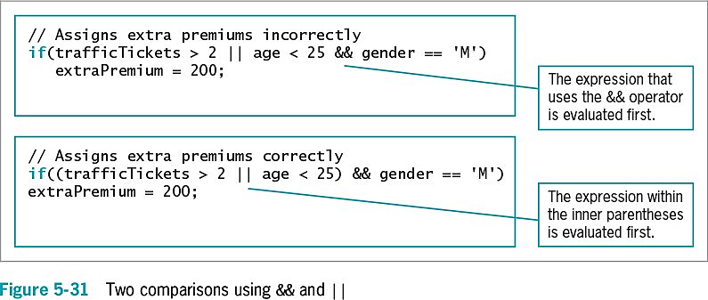
Understanding Operator Precedence (cont’d.)
Java Programming, Eighth Edition

Slide 45
Adding Decisions and Constructors to Instance Methods
Helps ensure that fields have acceptable values
Determines whether values are within the allowed limits for the fields
Java Programming, Eighth Edition

Slide 46
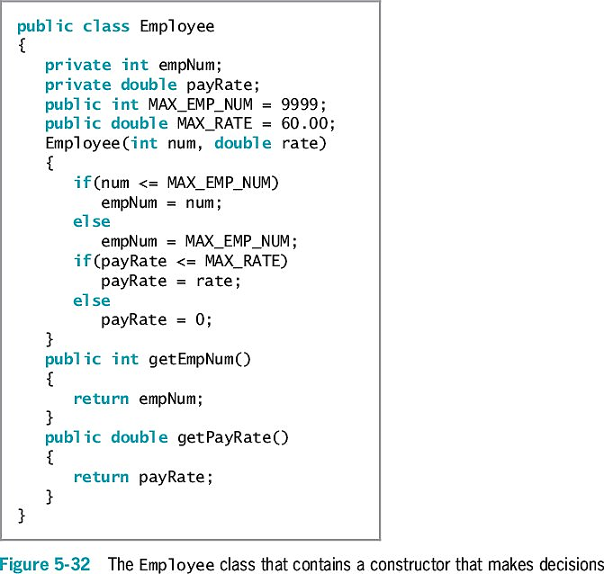
Adding Decisions and Constructors to Instance Methods (cont’d.)
Java Programming, Eighth Edition

Slide 47
You Do It
Using an if…else Statement
Using Multiple Statements in if and else Clauses
Using a Nested if Statement
Using the && Operator
Using the switch Statement
Adding Decisions to Constructors and Instance Methods
Java Programming, Eighth Edition

Slide 48
Don’t Do It
Don’t ignore subtleties in boundaries used in decision making
Don’t use the assignment operator instead of the comparison operator
Don’t insert a semicolon after the Boolean expression in an if statement
Don’t forget to block a set of statements with curly braces when several statements depend on the if or the else statement
Java Programming, Eighth Edition

Slide 49
Don’t Do It (cont’d.)
Don’t forget to include a complete Boolean expression on each side of an && or || operator
Don’t try to use a switch structure to test anything other than an integer, a character, or a string value
Don’t forget a break statement if one is required
Don’t use the standard relational operators to compare objects
Java Programming, Eighth Edition

Slide 50
Summary
if statement
  Makes a decision based on a Boolean expression
Single-alternative if
  Performs an action based on one alternative
Dual-alternative if
  if…else
  Performs one action when a Boolean expression evaluates as true
  Performs a different action when an expression evaluates as false
Java Programming, Eighth Edition

Slide 51
Summary (cont’d.)
AND operator
  &&
  Determines whether two expressions are both true
OR operator
  ||
  Carries out some action even if only one of two conditions is true
switch statement
  Tests a single variable against a series of exact integer or character values
Java Programming, Eighth Edition

Slide 52
Summary (cont’d.)
Conditional operator
  An abbreviated version of an if…else statement
NOT operator
  !
  Negates the result of any Boolean expression
Operator precedence
Java Programming, Eighth Edition

